Slide 1
Trammell Crow Woodland Industrial Site Plan Review/Major Variance/Critical Areas Permit Hearing WLD-2023-019
Hearing Examiner
Notice: This meeting will be recorded.
Starting at 1 p.m. February 28, 2024

Slide 2
Proposal
Two industrial buildings (931,186 sq. ft. total)
Up to four separate tenant spaces per building
Two Phases
Each building could be built as a phase

Slide 3
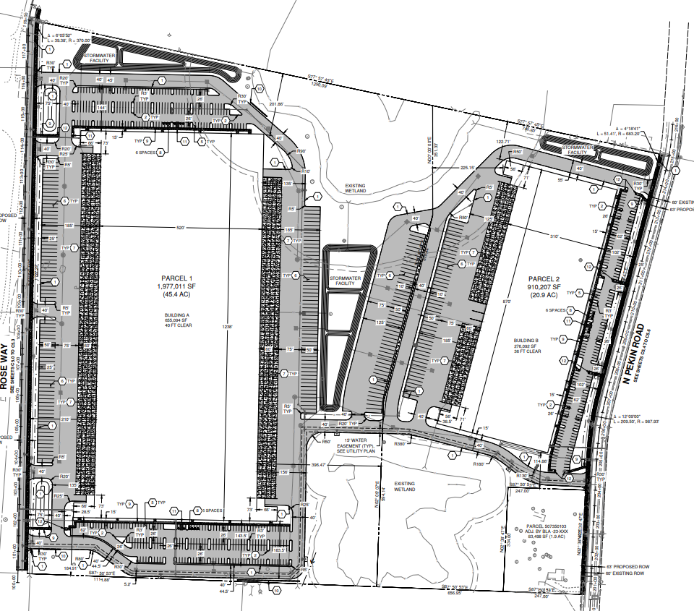
Site Plan
546 parking spaces
Trailer storage
191 loading docks
Rose Way extension (West side)
N Pekin Road frontage
Improvements (East side)

Slide 4
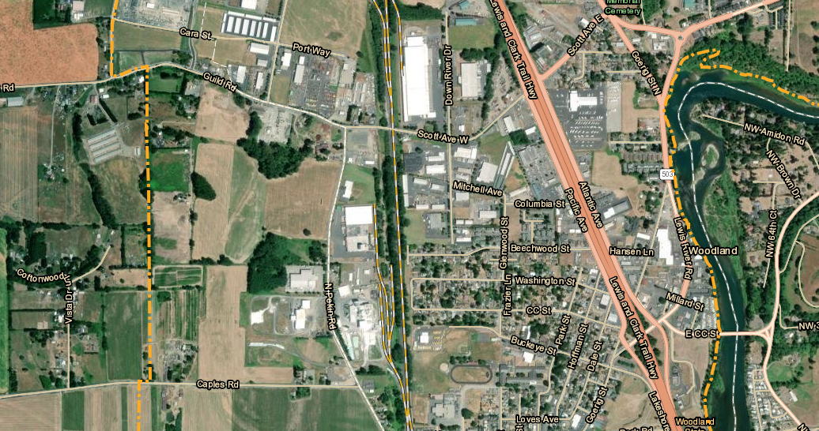
Location
Parcels
507350102 (22.91 acres) & 507350104 (46.92 acres)
Address
345 N Pekin Rd
Zoning
Light Industrial (I-1)

Slide 5
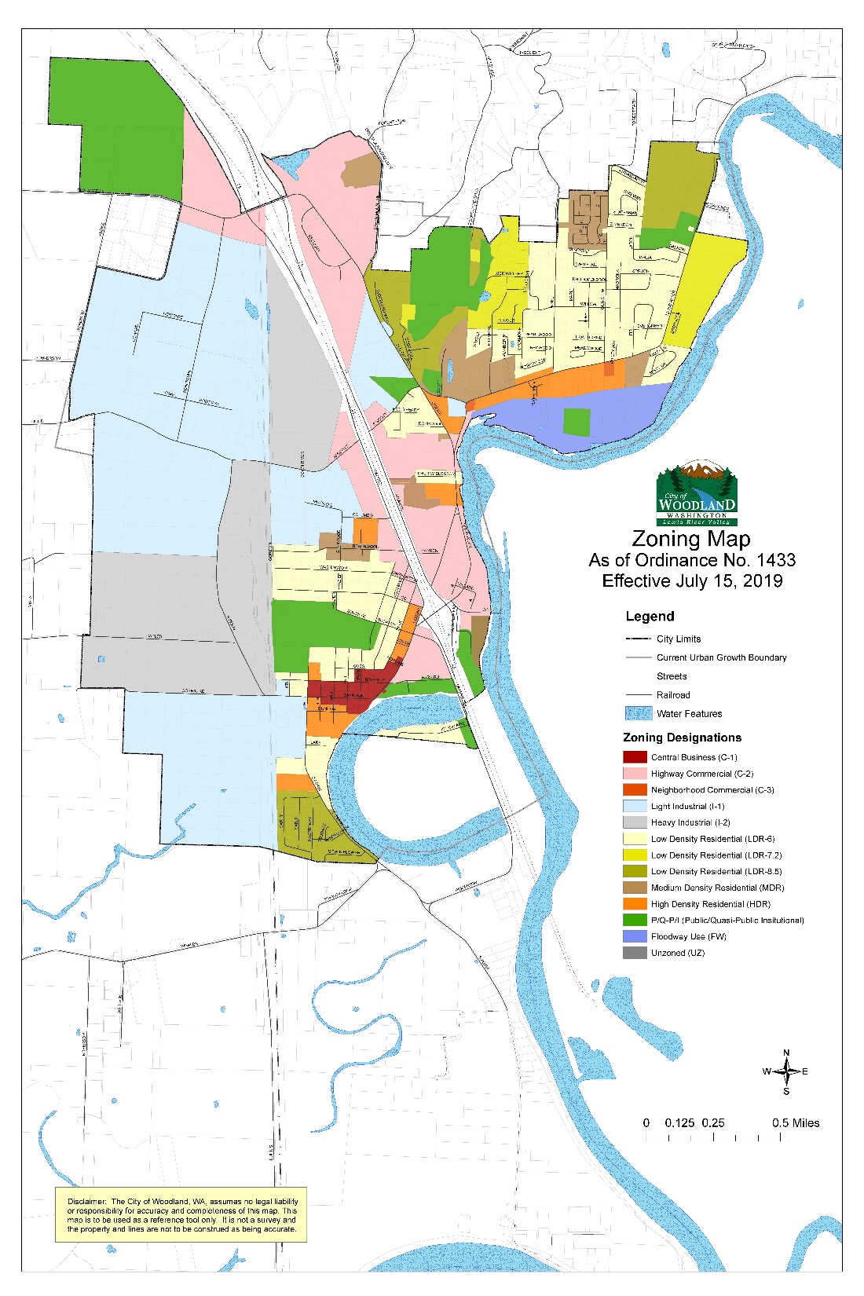
Light Industrial (I-1)
Permitted Uses, WMC 17.44.020:
Warehousing, storage, and distribution centers, including freight handling terminals

Slide 6
Development Standards
Front setback: 25 ft.
Side setback: 10 ft.
Rear setback: 10 ft.
Max building height:
55 feet to eave height if the property is larger than one acre in size.
Reference
Findings: 36-37
WMC 1744.070
WMC 17.44.080

Slide 7
SPR– Criteria to Approve
Proposal must comply with applicable regulations including:
Landscaping
Screening
Parking
Frontage improvements
Critical areas
Design
Sewer
Water
Stormwater
Erosion
Reference
Findings: 5-34, 39-40,

Slide 8
Critical Area Permit
Requirements:
Mitigation sequencing
Avoidance
Minimization
Repair
Restoration
Preservation/maintenance
Compensation
Monitoring

Slide 9
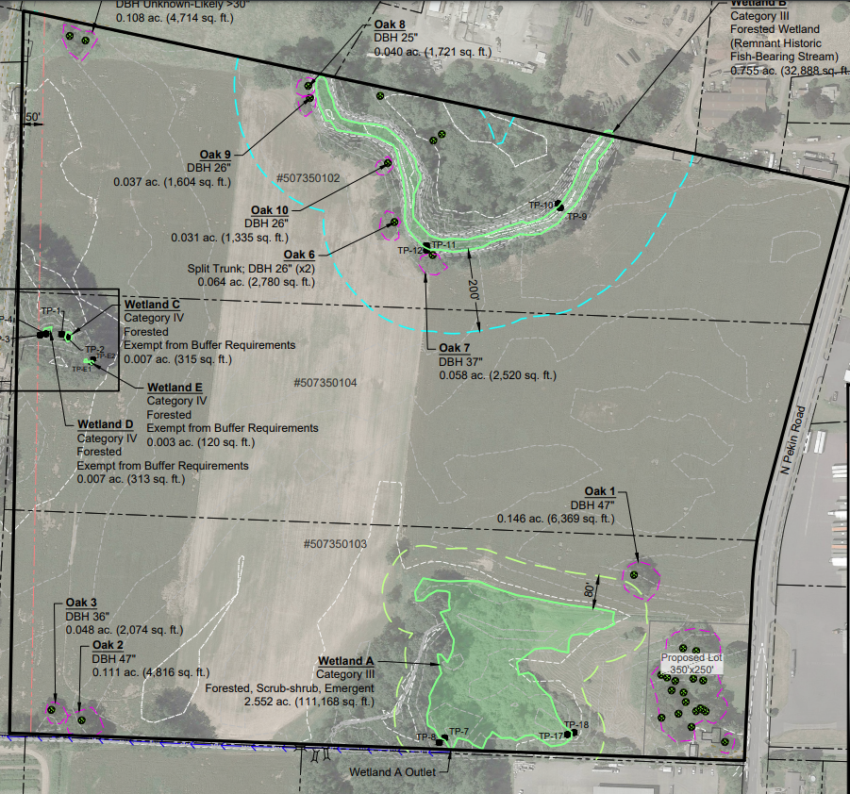
Critical Areas
Oregon white oaks
1 removed
587 sq. ft. of impacted dripline

Slide 10
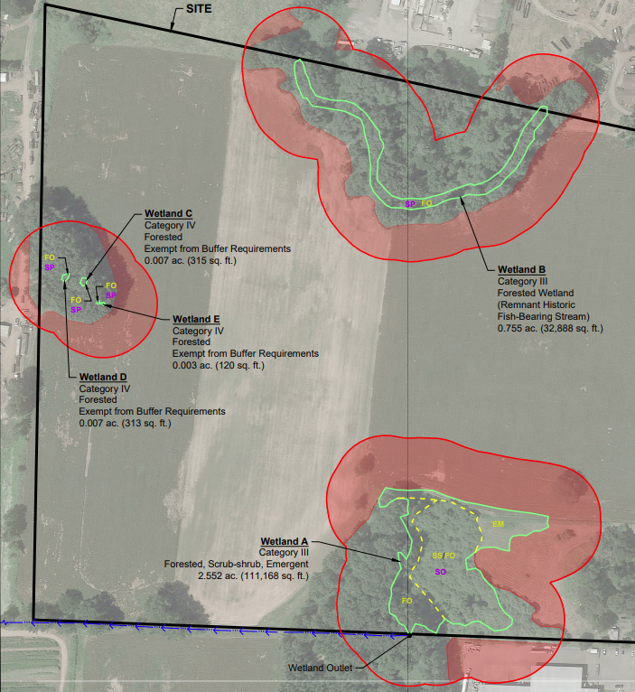
Critical Areas
2 regulated wetlands
Wetland A (bottom)
80-foot buffer
Wetland B (top)
80-foot wetland buffer but 200-foot RHA buffer
Plus smaller exempt wetlands
C, D, and E.

Slide 11
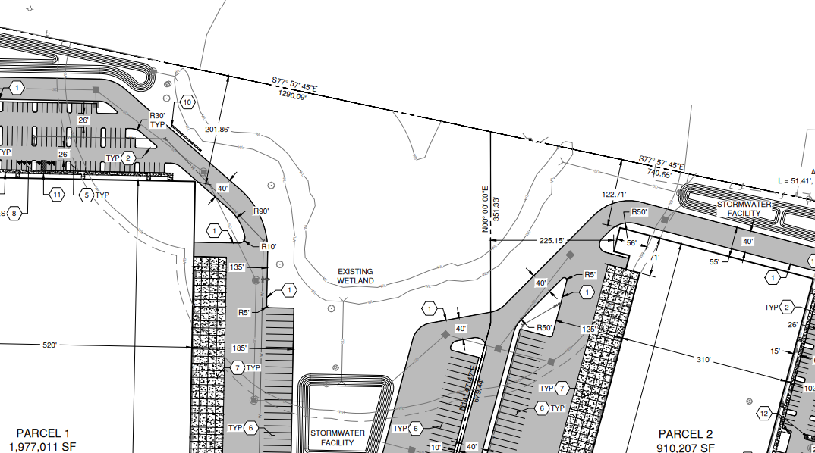
Major Variance
Applicants propose a reduction to the buffer of wetland B from 200 feet to 21 feet at its smallest width

Slide 12
Mitigation
Applicants submitted a critical areas report and mitigation plan prepared by Ecological Land Services, Inc. dated November 30, 2023, with an addendum dated February 16, 2024, to address staff’s comments

Slide 13
Mitigation
Mitigation proposed:
Enhance buffer with Oregon white oaks, shrubs, logs, woody pies, vertical snag, bird nests, and bat houses
0.077 credits of Columbia River Wetland Mitigation Bank

Slide 14
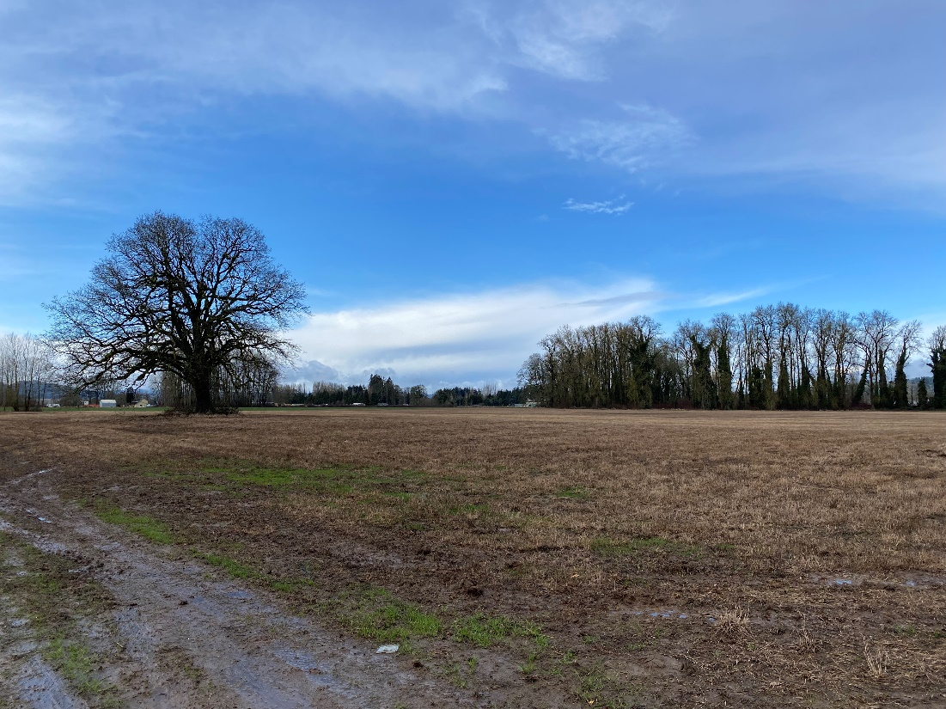
Site

Slide 15
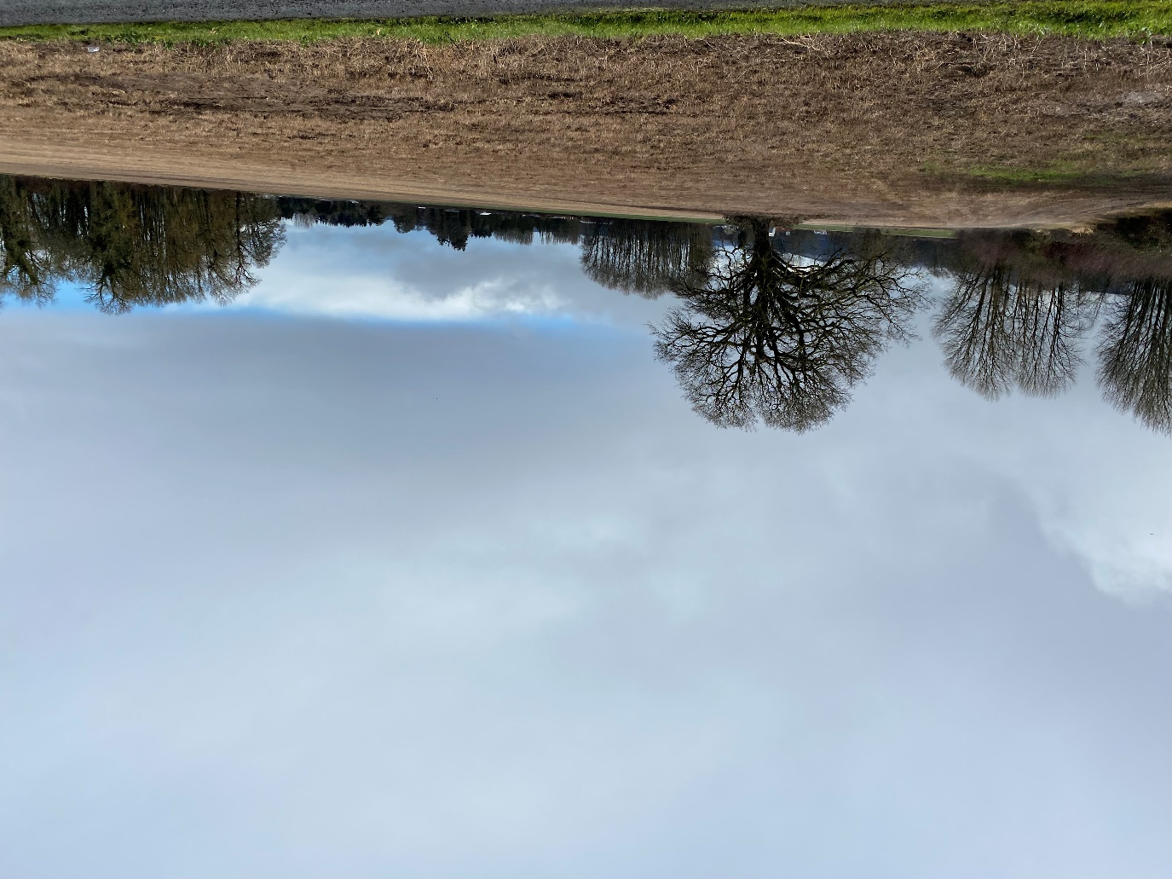
Site

Slide 16
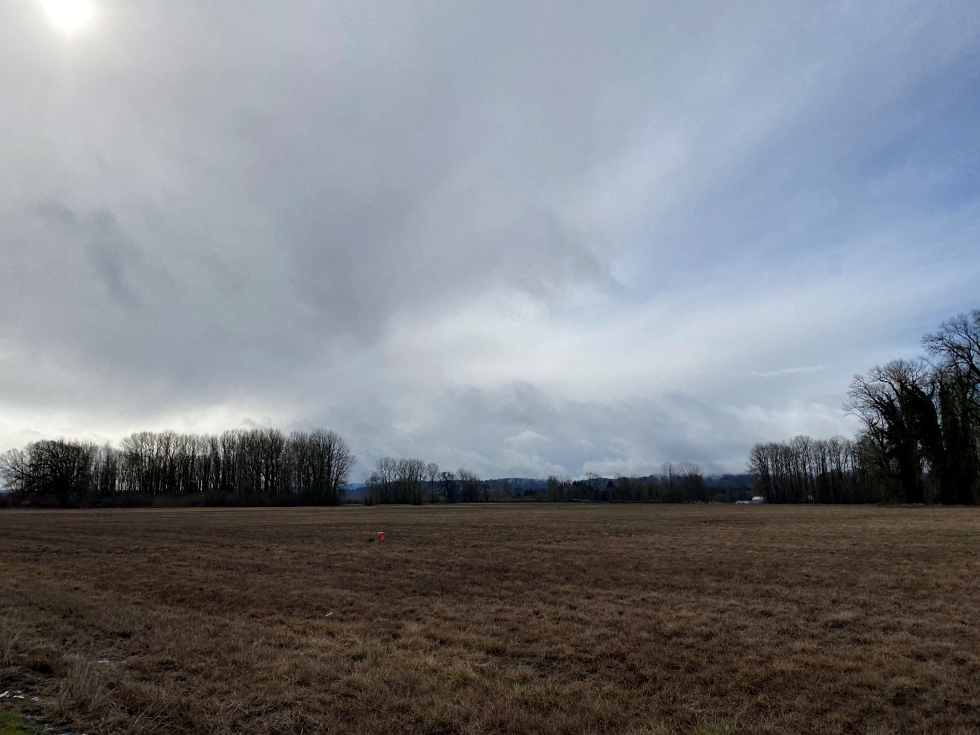
Site

Slide 17
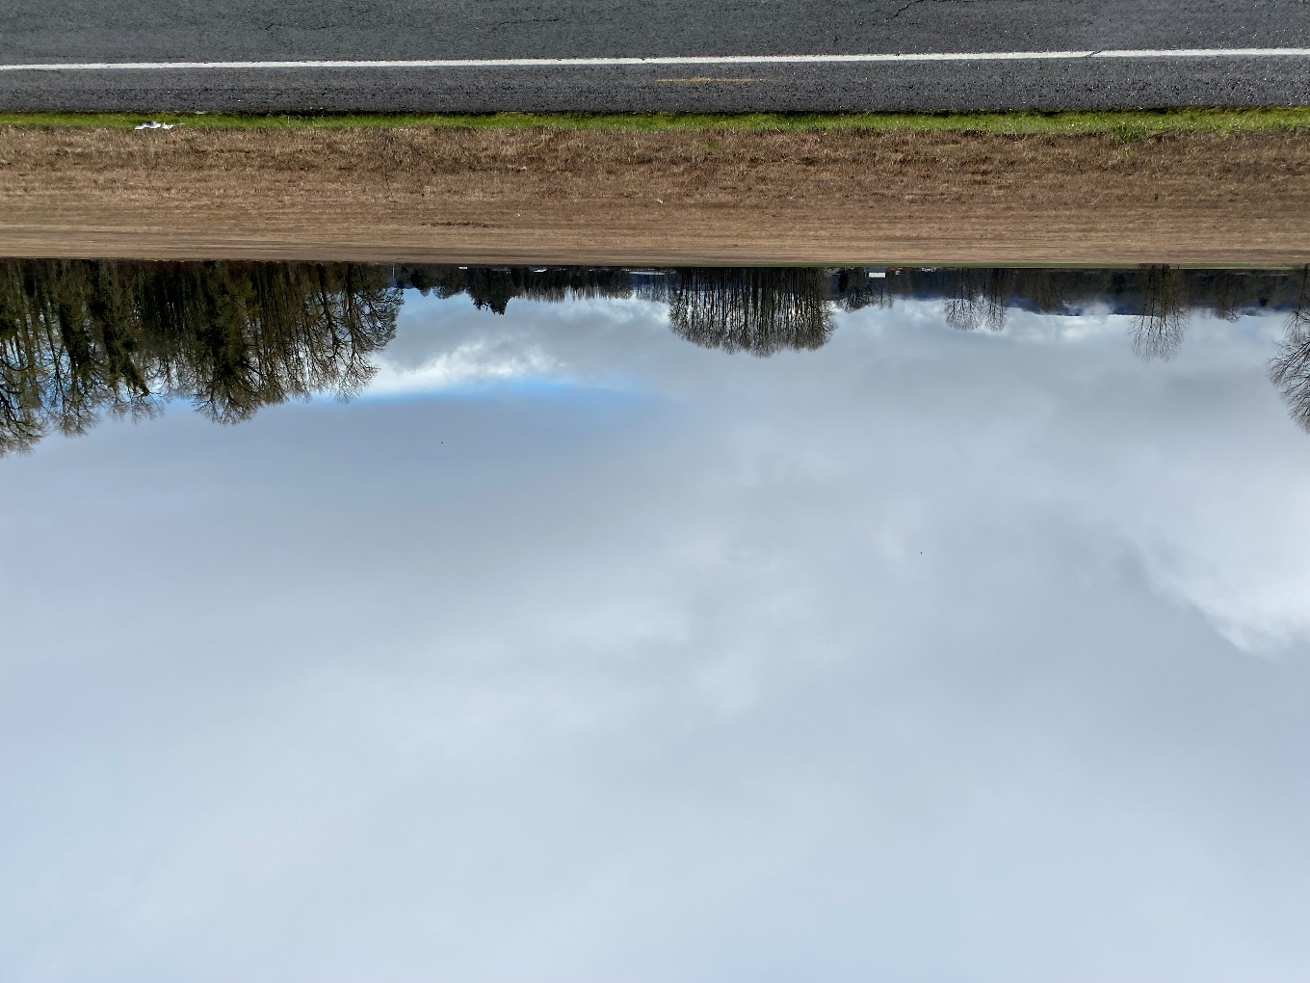
Site

Slide 18
Staff Recommendation
Proposal meets WMC
Approve with conditions
Reference
Section VI
Page: 15

Slide 19
Site Plan

Slide 20
Critical Area Variance Criteria
Circumstances or conditions, particular to the land on which the activity is proposed, exist that are special and are not applicable to other lands in the same area.
The special circumstances or conditions are not the result of actions of the applicant.

Slide 21
Critical Area Variance Criteria
Literal application of the provisions of this chapter would deny this applicant use and privileges enjoyed by other properties in the immediate vicinity, and the variance requested is the minimum necessary to provide that use and privilege.
No special privilege will be granted to the applicant that is denied other lands or structures under similar circumstances.

Slide 22
Critical Area Variance Criteria
The variance is consistent with the intent of this chapter.
The variance will not further degrade the functions or values of the critical area or be materially detrimental to the public health, safety, and welfare.

Slide 23
Critical Area Variance Criteria
The decision to grant is supported by best available science.
The variance is consistent with the city's comprehensive plan and zoning codes and other adopted development regulations.

Slide 24
Major Variance Criteria
That such variance is necessary, because of special circumstances or conditions relating to the size, shape, topography, location, or surroundings of the subject property, to provide it with use, rights, and privileges, permitted to other properties in the vicinity and in the zone in which the subject property is located.

Slide 25
Major Variance Criteria
That the granting of such variance will not be materially detrimental to the public welfare or injurious to the property or improvements in the vicinity and zone in which the subject property is situated.
No use variance shall be granted except for lawfully created pre-existing uses in accordance with WMC 17.60.

