Slide 1
Retooling Our Code 2023 Batch
City Council
Workshop
Notice: This meeting will be recorded.
Starting at 7 p.m. October 2, 2023

Slide 2
Section 1 (ORD 1546)
Title 1 – General Provisions
Removed “Old National Bank”
Replaced with Woodland Police Department (lobby)

Slide 3
Section 2 (ORD 1546)
Title 2 – CITY COUNCIL
Changed to reflect new location of Council Chambers
FROM 100 Davidson
To the Police station

Slide 4
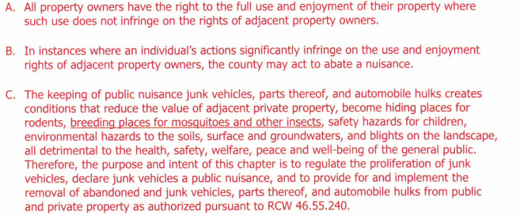
Section 3 (Cowlitz Code imported)
Title 8 – NUISANCES
Proposed Language

Slide 5
Section 4 (ORD 1546)
WMC 10.56.045 - Parking at restricted curbs – Safety Zones
Language has been proposed for the designation of safety zones and authorizing the police department to cite and tow vehicles that park in painted safety zones.

Slide 6
Sections 5 thru 11 (ORD 1546)
Title 16 - Subdivisions
Language has been proposed for requiring
Electronic copies in .pdf format
Removal of “mylar” from the code
Removal of references to “india” ink
Clarification of WMC 16.32.010 – Applicability
Clarification of duties for CDD to process subdivisions

Slide 7
Section 12 (ORD 1546)
ADA ramps in setbacks
Low-density Residential zones only
WMC 17.16.080 Performance Standards
6. Ramps for ADA access to existing residences, when in a required front, side or rear setback. Such exempt ramp structures must meet building code, fire code, and required lot coverage standard is not exceeded.

Slide 8
Section 13 (ORD 1546)
Code cross-reference correction
In that same code section regarding fence height, the cross reference should say (J) not (K)
This code section was adopted in 2000, and the codes subsections were renumbered at that time.
Subsection K talks about the height of Schools and Churches.
Subsection J talks about Sight Distance Requirements.
So, J is the only one that makes sense.

Slide 9
17.16.080 Performance standards.
The following special performance standards shall apply to properties located in the LDR district:
I. Fences, Walls and Hedges. Except as regulated under subsection (JK) of this section, fences and walls constructed shall not exceed a maximum height above the adjacent grade as set forth herein:
1. Fences, walls and hedges located within the required front yard or within a fifteen-foot setback from the street side property line shall not exceed a height of three feet where fences, walls and hedges would provide less than fifty percent visibility. Fences, walls, and hedges providing at least fifty percent visibility shall not exceed a height of four feet within the required front yard or within a fifteen-foot setback from the street side property line. Examples of fences that could meet the fifty percent visibility include spaced rail fences, spaced picket fences, and chain link fences.
2. Fences and walls located within the rear yard or interior side yard shall not exceed a total height of six feet.
3. On every lot where the adjoining lot is used for nonresidential purposes, then a fence of not to exceed six feet may be constructed along the side of the lot separating a residential lot from the lot being used for nonresidential purposes; provided, that when and if the adjoining lot is converted to a residential use, then the fence shall be altered to conform.
4. Fences utilized to enclose drainage detention ponds or other drainage facilities shall meet the above regulations, as well as any other applicable regulations of this code.

Slide 10
Section 13 (ORD 1546)
WMC 17.16.080 – Performance Standards
Fences in street side yards and reverse lot yards.
The responsible official may approve a six (6) foot fence on a lot line if the lot has multiple lot lines fronting on a street. Such fences must meet sight distance requirements, if not located in the front yard, and may only be approved if the fence fronts on one of the streets:

Slide 11
Taller Fence Opportunities
State Route – 503 (aka SR-503 and Lewis River Road)
5th Street south of Davidson Avenue
South Pekin from 5th Street to the South City Limits
North Goerig Street from East Scott Avenue to SR-503
East Scott Avenue from Interstate Five (I-5) to Old Pacific Highway
Hillshire Drive
Insel Road
Gun Club Road

Slide 12
State Route 503

Slide 13
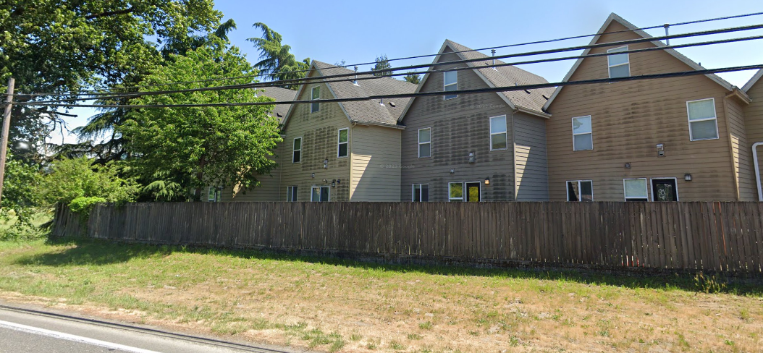

Slide 14
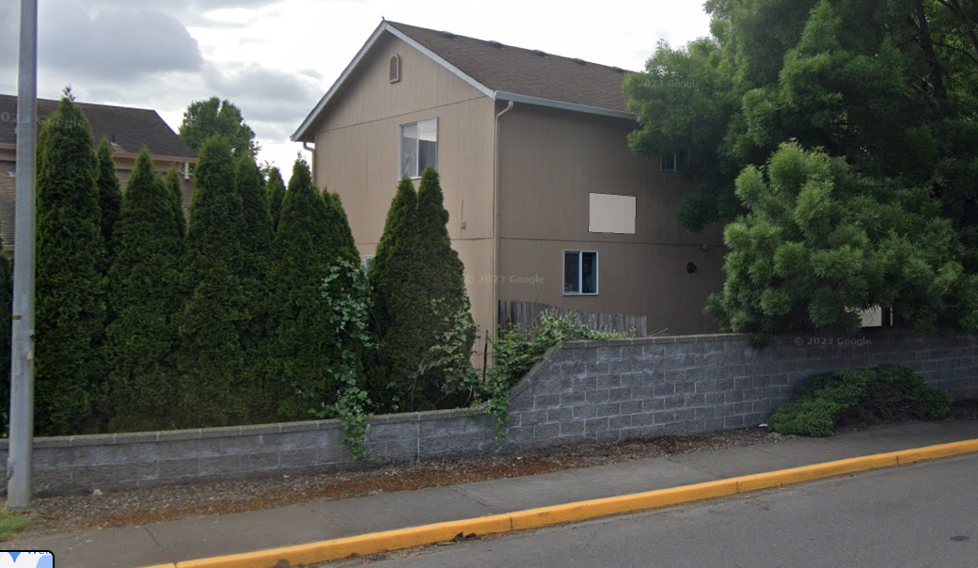
Gun Club

Slide 15
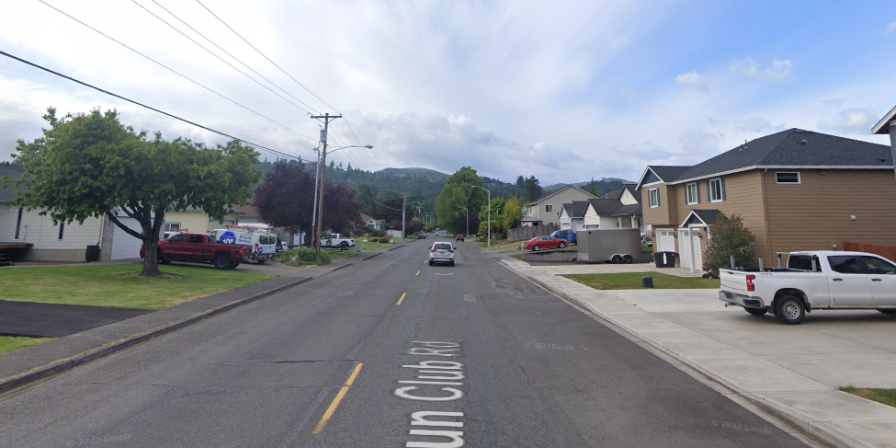
Doesn’t apply to front yards

Slide 16
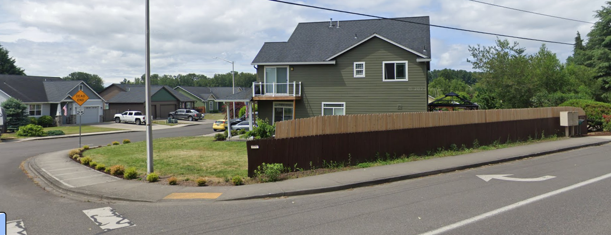

Slide 17
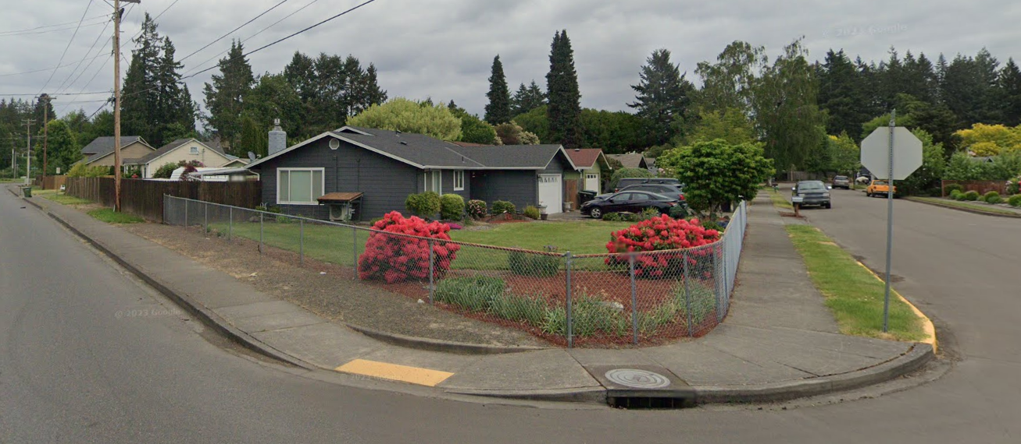
East Scott Avenue

Slide 18
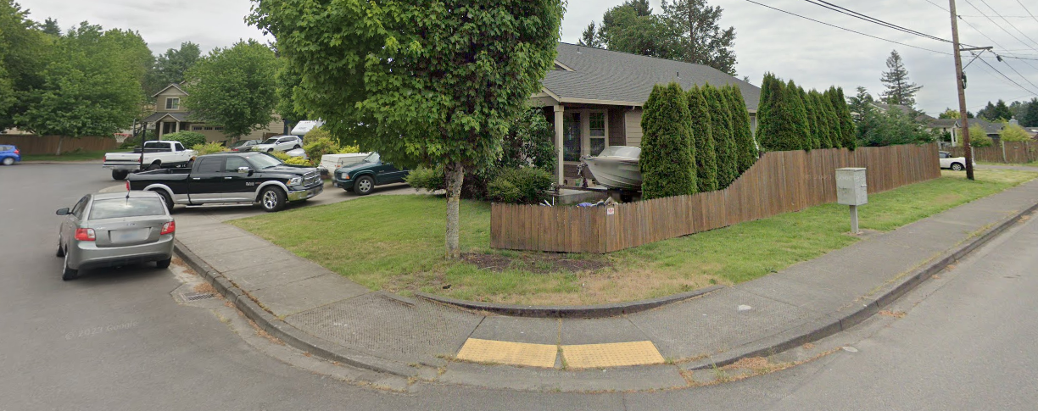

Slide 19
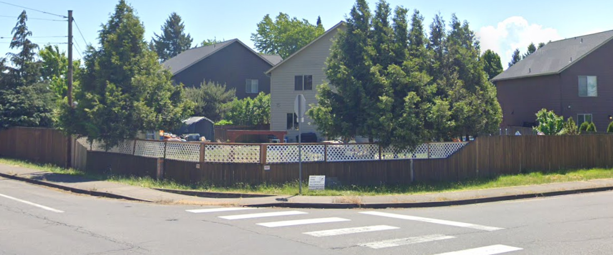

Slide 20
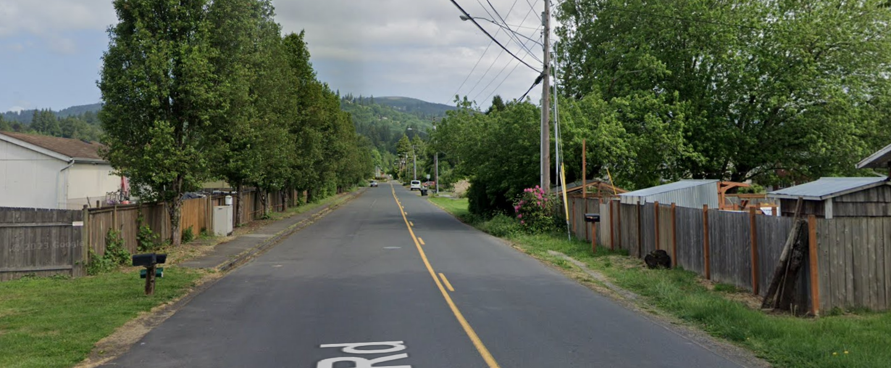
Insel

Slide 21
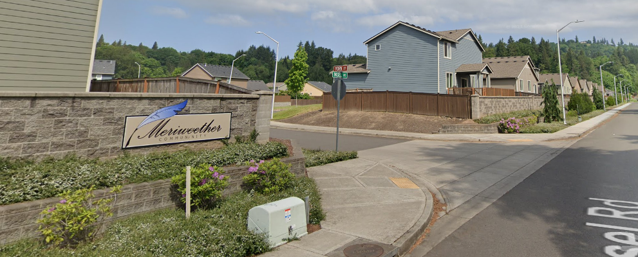

Slide 22
Section 14 & 15 (ORD 1546)
Title 17 – Zoning corrections
Changes “an” to “and” in WMC 17.36.130
Add the word “in” to WMC 17.44.240
“Development listed WMC 14.44…”
“Development listed in WMC 14.44…”

